Slide 1
ORCID ID’s: Optimizing Research Discoverability
Updated 1 September 2014
Notes:
Notes for presenter:
Thank you!

Slide 2
The problem
The research community has lacked the ability to link researchers with their professional activities.
As a researcher, you want to
  ensure your work is discoverable and connected to you throughout your career;
  minimize the time you spend entering repetitive data online; and
  eliminate name ambiguity, distinguishing you from other researchers and ensuring proper attribution.

Slide 3
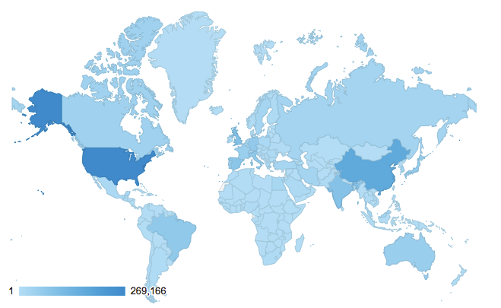
How can ORCID help?
ORCID provides you with Ia unique and persistent personal identifier that connects you and your research activities throughout your career.
  Open, non-profit, community-driven organization
Website and registry localization for multiple languages in process
More than 750,000 IDs issued to date
Registry use is international
Notes:
Notes for presenter:
ORCID is unique in its ability to reach across disciplines, research sectors and national boundaries and in its cooperation with other identifier systems.
The ORCID identifier is a key component that supports system-to-system interoperability.
ORCID is a non-profit organization, working in collaboration with other stakeholders in the research community.
ORCID is an open, collaborative effort. Our source code is open for other institutions to use.
Design notes:
The number of iDs issued increases regularly. Registry statistics are updated weekly and are available at https://orcid.org/statistics.

Slide 4
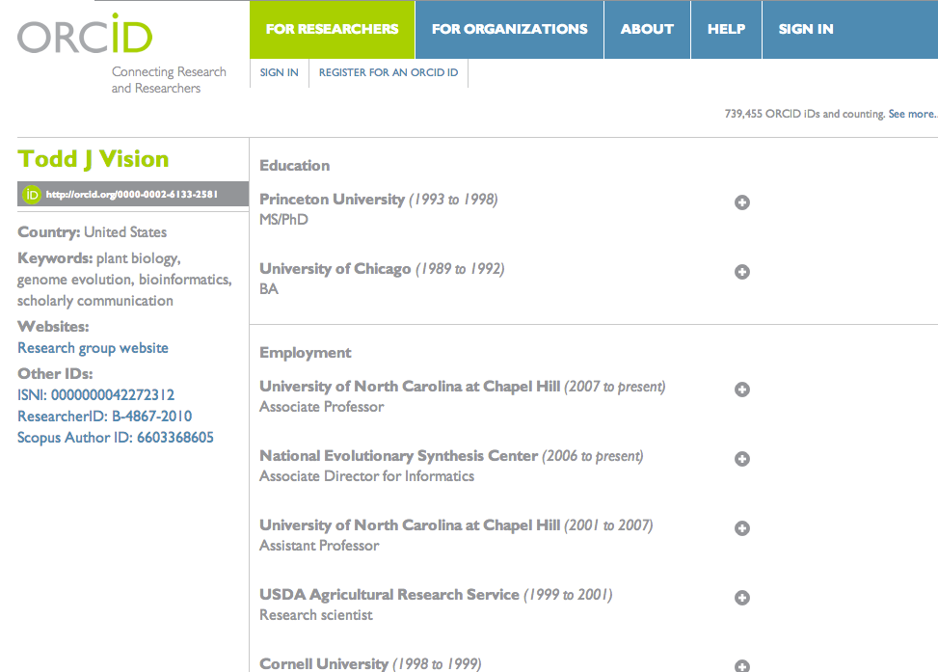
What does an ORCID page look like?
Notes:
Notes for presenter:
Here’s what an ORCID page looks like.
Point out the iDeas button.
Design note:
This is a placeholder slide with Todd Vision’s ORCID page; we encourage you to replace this with your own ORCID page.
The ORCID iD is circled for easy reference.

Slide 5
ORCID is a hub connecting the research landscape
Universities & research institutions
Publishers / Manuscript submission systems
Funding agencies
Other research identifiers
Repository & more
Research & scholarly societies
Notes:
Notes for presenter:
ORCID is a hub that connects you and your research activities through the embedding of ORCID identifiers in existing research workflows, data systems and other identifier systems.
ORCID iDs do not replace existing researcher identifiers; rather ORCID creates links among these identifiers, further helping to connect research and researchers throughout the world.
Broad support from all segments of research community.
The full member list is available at: http://orcid.org/about/community/members if you’d like to give some examples during your presentation

Slide 6
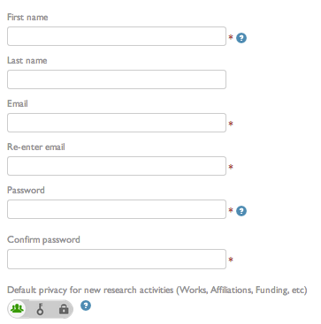

Registration is free and fast
Registration is easy. Signing up for an ORCID ID only takes seconds. Then, enhance your ORCID record with your professional activities and begin to use your ORCID ID as you submit publications, apply for grants, and in any research workflow to ensure you get credit for your work.
Notes:
Notes for presenter:
Registration takes seconds. Emphasize that it is FREE for researchers.

Slide 7
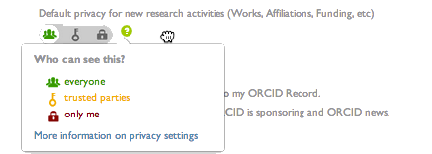
You control the privacy
You determine what, how, and with whom the information in your ORCID record is shared.
Notes:
Notes for presenter:
Privacy is controlled at the item level.
Even if an employer sets up your ORCID record, upon claim you maintain sole control privacy settings.
There are three levels of privacy, indicated by the icons in the slide above:
Public Data: Data which are completely viewable and open for public use
Limited Access Data: Data which are only viewable by parties you (or someone you designate) select
Private Data: Data which are not viewable by third parties via the registry
The default setting is public, and this will help ensure maximum discoverability of your research. In cases where you might wish to restrict access to an item, you can choose to restrict access completely OR limit only to “trusted parties” you agree to, such as your employer or perhaps a funding agency.
ORCID has an extensive privacy policy, and additional information is available at http://orcid.org/privacy-policy.

Slide 8
For benefits to be realized…
Researchers must claim and use ORCID IDs
Research information processes and systems must embed ORCID IDs and link back with the ORCID Registry
Notes:
Notes for presenter:
Before we talk about the benefits, we want to highlight a key point in order for the mission of ORCID – and the benefits to you – to be realized
Researchers must register for and use an ORCID iD
Organizations (such as universities, funders, publishers) must embed ORCID iDs and link them back to the ORCID registry.
The reality is that the registry of researchers is growing at the same time that integration/functionality is growing.
Organizations are embedding ORCID iDs into systems for them to benefit from ORCID's interoperability.
The research community must support the ORCID mission by becoming a member. As more organizations embed ORCID iDs, the more powerful the ORCID registry becomes.

Slide 9
Adoption and integration
ORCID has issued over 750,000 IDs since our launch in October 2012.
Integration and use is international.
Updated 13 June 2014
Notes:
Notes for presenter:
Registration takes seconds. Emphasize that it is FREE for researchers.

Slide 10
Benefits to Researchers
Notes:
Notes to presenter:
Here’s where we get to the best part: how ORCID iDs benefit you, the researcher

Slide 11
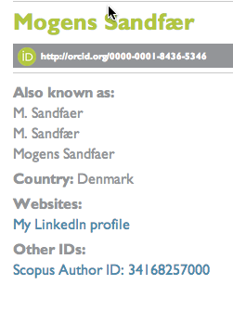
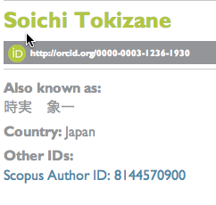
Eliminate name ambiguity
Notes:
Notes for presenter:
One person may have multiple name variations.
ORCID iDs eliminate name ambiguities, distinguishing you from other researchers and helping to ensure your work is attributed to you.
Design note:
Feel free to replace these images with ones that works better for your audience.

Slide 12
An illustrative example: Jens Åge Smærup Sørensen
J. Å. S. Sørensen
J. Aa. S. Sørensen
J. Å. S. Sorensen
J. Aa. S. Sorensen
J. Å. S. Soerensen
J. Aa. S. Soerensen
Jens Å. S. Sørensen
Jens Aa. S. Sørensen
Jens Å. S. Sorensen
Jens Aa. S. Sorensen
Jens Å. S. Soerensen
Jens Aa. S. Soerensen
J. Åge S. Sørensen
J. Aage S. Sørensen
J. Åge S. Sorensen
J. Aage S. Sorensen
J. Åge S. Soerensen
J. Aage S. Soerensen
Jens Åge S. Sørensen
Jens Aage S. Sørensen
Jens Åge S. Sorensen
Jens Aage S. Sorensen
Jens Åge S. Soerensen
Jens Aage S. Soerensen
J. Åge Smærup Sørensen
J. Aage Smaerup Sørensen
J. Åge Smarup Sorensen
J. Aage Smarup Sorensen
J. Åge Smaerup Soerensen
J. Aage Smaerup Soerensen
Jens Åge Smærup Sørensen
Jens Aage Smaerup Sørensen
Jens Åge Smarup Sorensen
Jens Aage Smarup Sorensen
Jens Åge Smærup Soerensen
Jens Aage Smaerup Soerensen
And on and on it goes …
Notes:
Notes for presenter:
Names may be spelled, abbreviated and presented in multiple formats — all which contribute to the confusion about the researcher’s identity. In this example, when you take the Danish name Jens Åge Smærup Sørensen, you find that it can be represented in several dozen formats. How confusing! Using a unique, persistent ORCID identifier removes this ambiguity.
Design note:
Feel free to replace this image with one that works better for your audience.

Slide 13
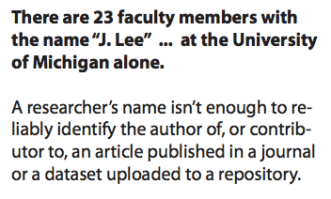
How can we tell one researcher from another?
http://deepblue.lib.umich.edu/bitstream/handle/2027.42/101738/CIDays13_ORCIDFinal.pdf?sequence=11
Notes:
Design note:
Feel free to replace this image with one that works better for your audience.

Slide 14
Improve discoverability & reduce repetitive data entry
Funders
Researcher information systems
Professional societies
Membership renewal
Publishing & repositories
Grant submission systems
Universities
Publishers are integrating into manuscript submission and author/reviewer databases
Repositories linking with deposition, search and updating
Institutional repositories
Grants & contracts
HR systems
And creating records for students & faculty
Both are linking internal ID with ORCID record
Integrating with:
Awardee databases
Publishing and meeting registration processes
Notes:
Notes for presenter:
Through linkages with other systems, ORCID reduces repetitive data entry associated with the increasing diversity of research information systems with which you interact.
By creating links among your professional activities, ORCID improves discoverability, allowing you to easily share your research work.
ORCID iD stays with you your entire career.
Embedding is widespread:
University CRIS/research information, or researcher profile systems
Manuscript submission
Grant applications
Linkage with repositories
Linkage with other IDs

Slide 15
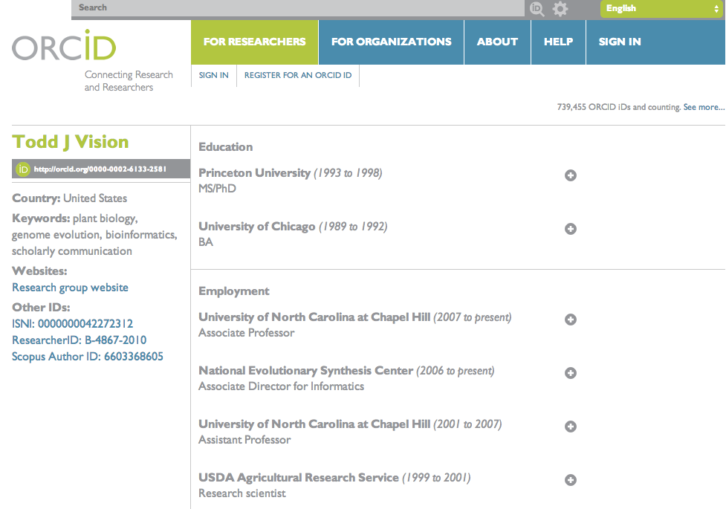
Reduce time-consuming data entry & activity reporting
Notes:
Notes for presenter:
ORCID reduces time-consuming data entry and activity reporting by linking your research affiliations and activities with your ORCID iD.
Include your ORCID iD when you submit a manuscript, dataset or grant so that your ORCID record, local repository, grant management system post award reporting system may be updated.
Design note:
This is a placeholder slide with Rebecca Bryant’s ORCID page; we encourage you to replace this with your ORCID page or other examples you feel may be more relevant for your audience.

Slide 16
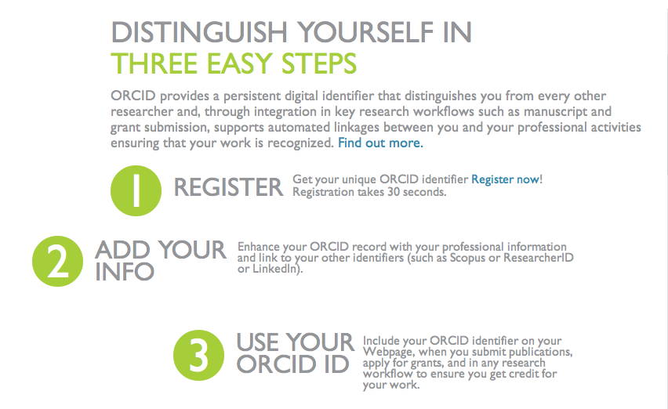
Distinguish yourself
Notes:
Notes for presenter:
Here are the three simple steps you should take to enjoy all of the benefits. The following slides provide additional detail and support.
You can go to http://orcid.org to begin this process.

Slide 17

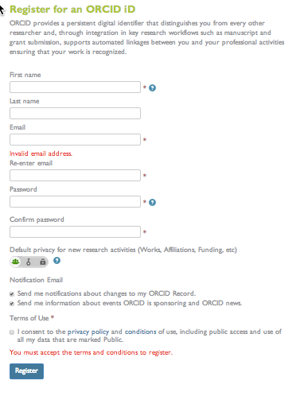
The ORCID
1. Register for an ID
http://orcid.org/0000-0002-1825-0097
16-digit number, expressed as URI
Free and fast—takes about 30 seconds
Sign up now! orcid.org/
Notes:
Notes for presenter [go through slide]:
Register for an ORCID iD
International Standard Name Identifier (ISNI): ISNI has reserved a block of numbers for use by ORCID, to avoid assignment overlaps.
All you need to set up your ORCID iD is your name and an email address.

Slide 18
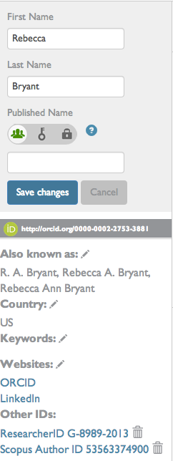
2. Add your info: Name variants
Add variants of your name before you link works—this will ensure that you will find all of YOUR works. You can add names in multiple character sets.
Notes:
Notes for presenter:
Click on UPDATE by “Personal Information”
This brings you to the EDIT PERSONAL INFORMATION page.
Here you can other variants of your name. This is important because you may have publications under all of these variations—update your name before you import to works to be certain to find them all. You can also add names in any character set.
Add a biography and keywords to help others discover your work
You may also add links to websites such as LinkedIn, a personal web page, and more.
You can make each item public, limited, or private.

Slide 19
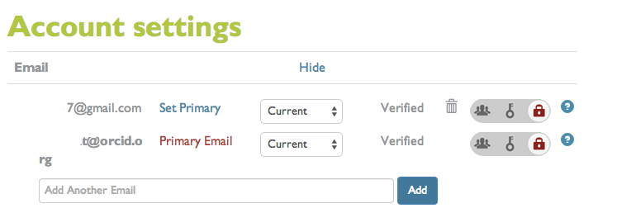
2. Add your info: Email addresses
Notes:
Notes for presenter:
Click on UPDATE under your name.
This brings you to the Edit personal information page.
Click on “Edit email.”
Add additional email addresses. Having multiple email addresses can help support interoperability.
From this page, you can also manage your privacy preferences, password and security, and manage permissions with trusted organizations.

Slide 20
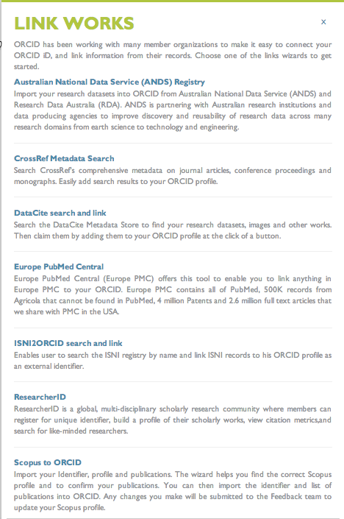
2. Add your info: Link works
Use the multiple ORCID search and link wizards to connect your works to your ORCID record.
Following linking, these records will appear in your ORCID record with no data entry by you
Notes:
Notes for presenter:
ORCID makes it easy to connect your ORCID iD to your other works
Search and add your works
Add multiple email addresses
Link to other researcher identifiers
This doesn’t take very long but this is how you will achieve all of the benefits such as:
Ensuring your work is discoverable and connected to you throughout your career
Minimizing the time you spend entering repetitive demographic and bibliographic data online
Overcoming name ambiguity, distinguishing you from other researchers and helping ensure your work is attributed to you
Click on “Import Research Activities” at bottom left of your profile page. That will take you to the page pictured here. Click on the hyperlink to begin the import process.
Note that Scopus and CrossRef are the two imports wizards available now — this list will grow in the future.
We encourage you to use multiple interfaces to make sure all of your works are identified and added to your ORCID record.

Slide 21
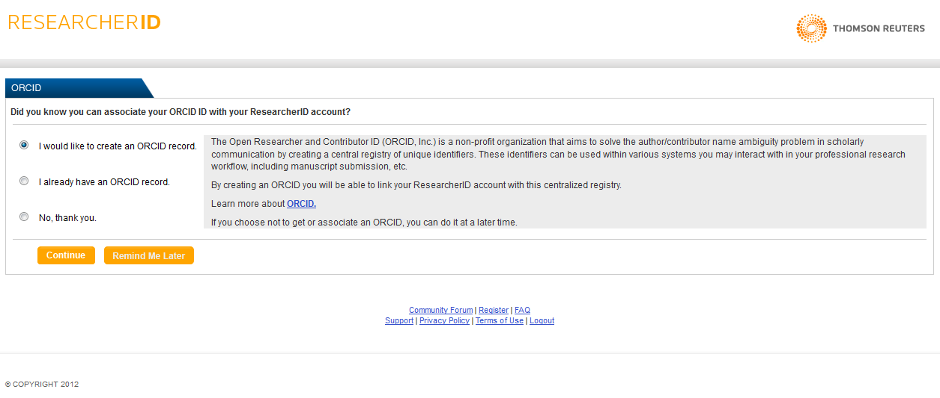
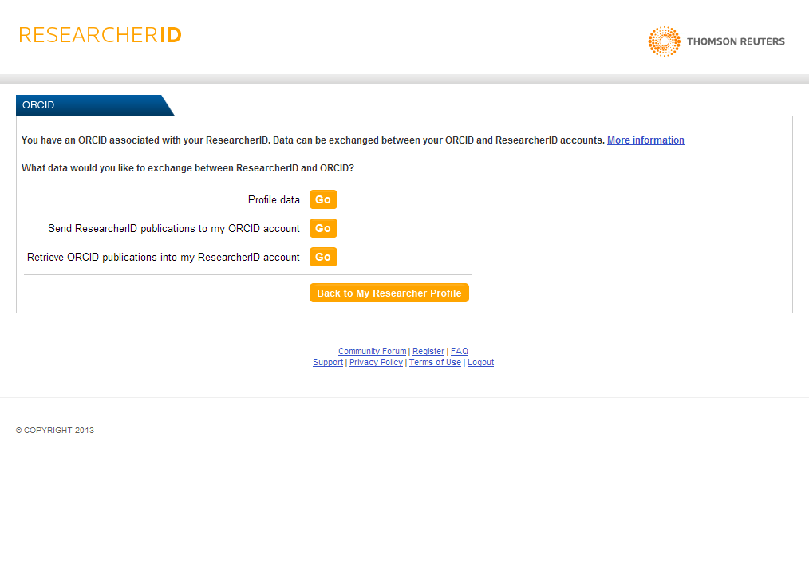
2. Add your info: Link to other identifiers
Associate your ORCID ID with ResearcherID
Exchange profile and/or publication data between ORCID and ResearcherID
Notes:
Notes for presenter:
You may have existing researcher identifiers, such as ResearcherID.
These are screen shots from the ResearcherID interface. You can go to ResearcherID and associate your ORCID iD there. Through this, you can pull publications into ORCID from ResearcherID and/or pull publications from ORCID into your ResearcherID record.
We expect additional identifiers in the future.

Slide 22
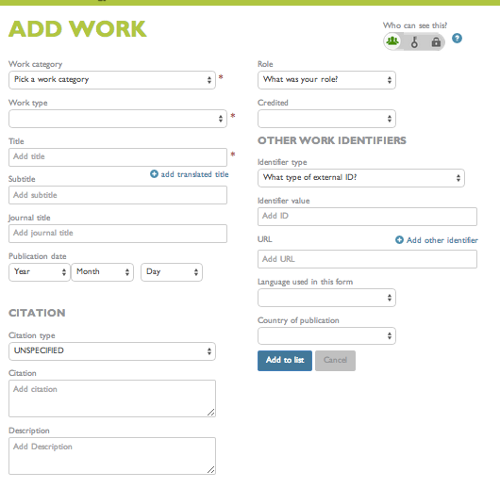
2. Add your info: Add works manually
Some of your works may not be included in the search results to link.
You can add them to your ORCID record manually.
Notes:
Notes for presenter:
Some of your works may not be included in the search results.
You can add them manually by clicking on the “Add Manually” tab.
Be sure to click “Save” before leaving this page.

Slide 23
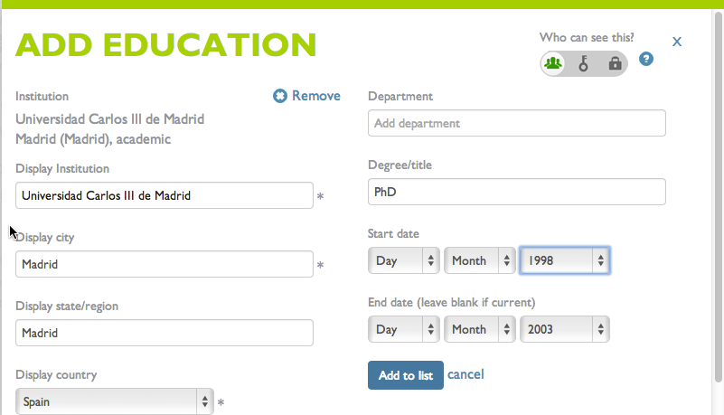
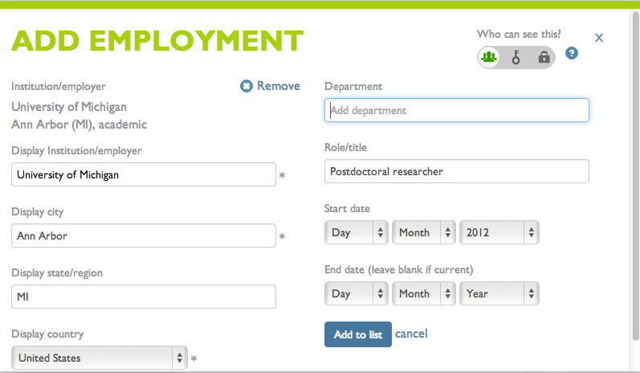
2. Add your info: Education & employment history
Notes:
Notes for presenter:
Encourage researchers to add educational and employment information—past and current.
Start typing in the name of your institution—you will be presented with a list of options.
Most institutions and organizations are available. If not, please let us know at support@orcid.org. We are working collaboratively to ensure that this list is complete and up-to-date.
Entering date information is option. If you don’t enter an end date, it will populate as current.
You can choose to include a year only if you like.
You may enter multiple institutions, and they will appear in your ORCID record in reverse chronological order.

Slide 24
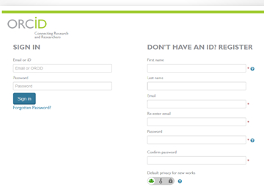
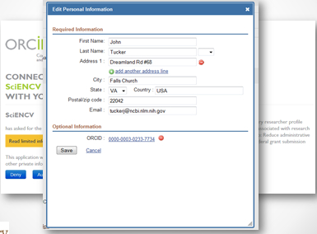
3. Use your ORCID ID in. . . grant applications
Link grant application to ORCID identifier
Import information from ORCID record
Funding organizations like the Wellcome Trust and the U.S. Department of Energy are now requesting your ORCID ID during grant submission.
Notes:
Notes for presenter:
In order for the entire research community to achieve the mission of ORCID and for researchers to realize the full benefits of having an ORCID iD, researchers must use their ORCID iDs.
Here are some examples of how you can use your iD:
Use your iD in grant applications
Here’s an example to demonstrate this step: in Summer 2013, the U.S. National Institutes of Health (NIH) is creating an application to facilitate grant/fellowship applications and the sharing of biosketch information between multiple U.S. federal funding agencies. This application is called ScienCV and a beta version will be available for NIH pilot in late summer/early fall 21013. Implementation by other U.S. funding agencies is expected to follow. Other international funders are also beginning integrations.
Design note:
We have provided several examples. All may not be relevant for each audience. Feel free to delete the examples that do not apply to your audience.

Slide 25

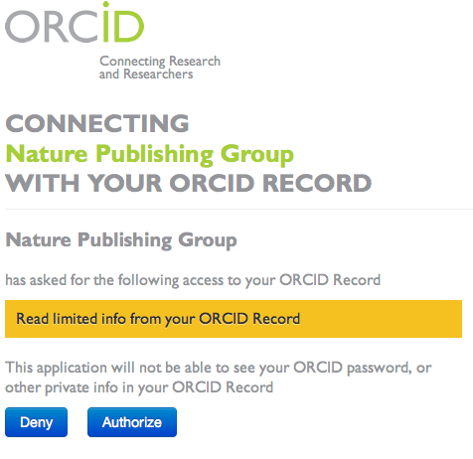
3. Use your ORCID ID in. . . manuscript submission
Include your ORCID ID when submitting a manuscript. Your ORCID ID is attached to your publication metadata, improving discoverability.
Notes:
Notes for presenter:
Use your iD in manuscript submissions
Here’s an example to demonstrate this step; Nature Publishing Group journals authors can link their ORCID to their account in Nature’s manuscript submission and tracking system, and Nature will soon be publishing authors’ ORCID iDs in papers.
ORCID iDs are becoming part of the final journal article metadata used by publishers, and already being done by Nature Publishing Group and Hindawi.

Slide 26

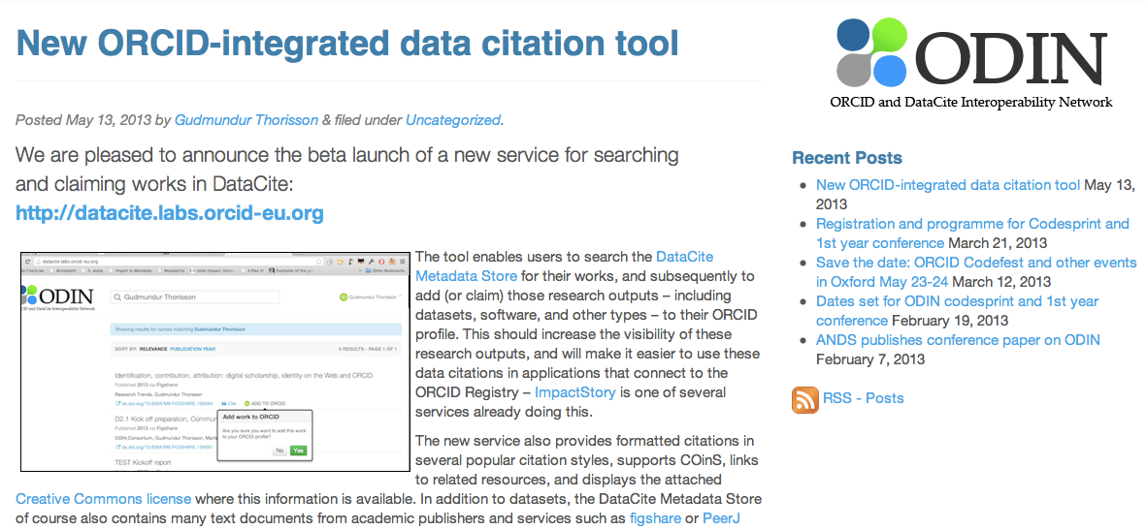
3. Use your ORCID ID. . . Link to datasets
You can now link your ORCID ID with your data, enabling you to display your datasets in your ORCID profile.
Notes:
Notes for presenter:
It is becoming increasingly possible to manage attribution with the assignment of DOIs to data sets. These then can be linked to ORCID.
For example, Figshare now allows users to exchange dataset metadata between Figshare and ORCID. Other organizations like Dryad are also planning to implement ORCID registration/authenticated identifier exchange at the time of dataset deposition.
ODIN, the ORCID and DataCite Interoperability Network, released a beta version of the DataCite / ORCID Integration tool, enabling researchers to search DataCite and import metadata from objects with DataCite DOIs to their ORCID record.
Additional information at http://orcid.org/blog/2013/06/17/connecting-research-datasets-and-researchers

Slide 27
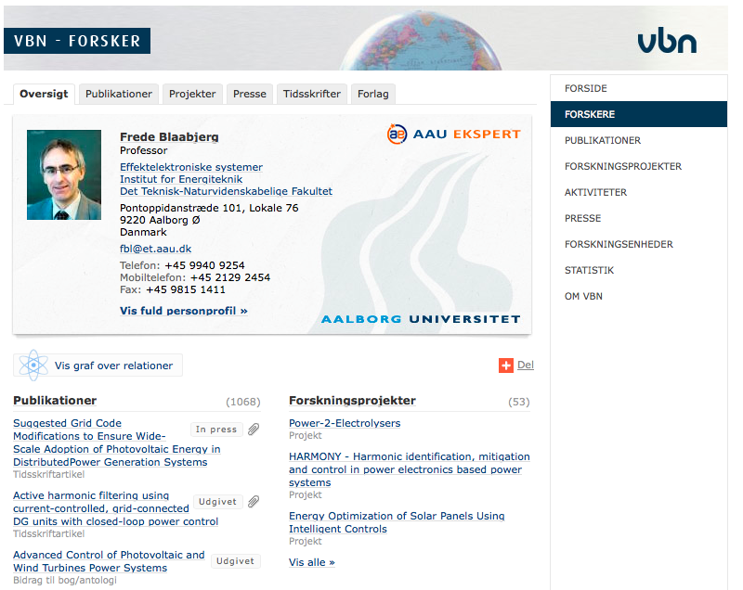

3. Use your ORCID ID:
Researcher information system integration
Notes:
Notes for presenter:
We are increasingly seeing institutions integrate ORCID identifiers with their own systems.
This example is from Boston University, which is integrating with its local BU Profiles system. Data can be shared between systems, and as a user at an institution like Boston University, you can pull data from the local system into your ORCID record.
These types of systems will be growing rapidly — watch if your institution or employer to offer this functionality! One way to tell is if they are a member institution: http://orcid.org/about/community/members. If not, then talk with your institution or organization to suggest that they integrate with ORCID!

Slide 28
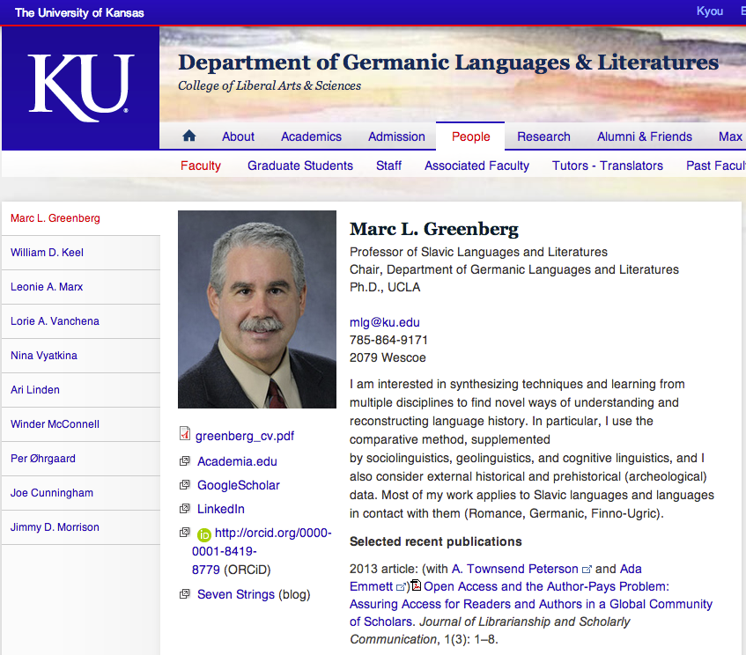
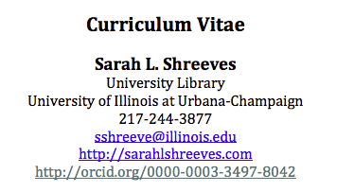

3. Use your ORCID ID: Email signature, web page, CV and more
Notes:
Notes for presenter:
Don’t overlook easy opportunities to share your ORCID iD (e.g., your email signature or CV)
Design note:
Feel free to replace these examples with ones that work better for your audience.

Slide 29
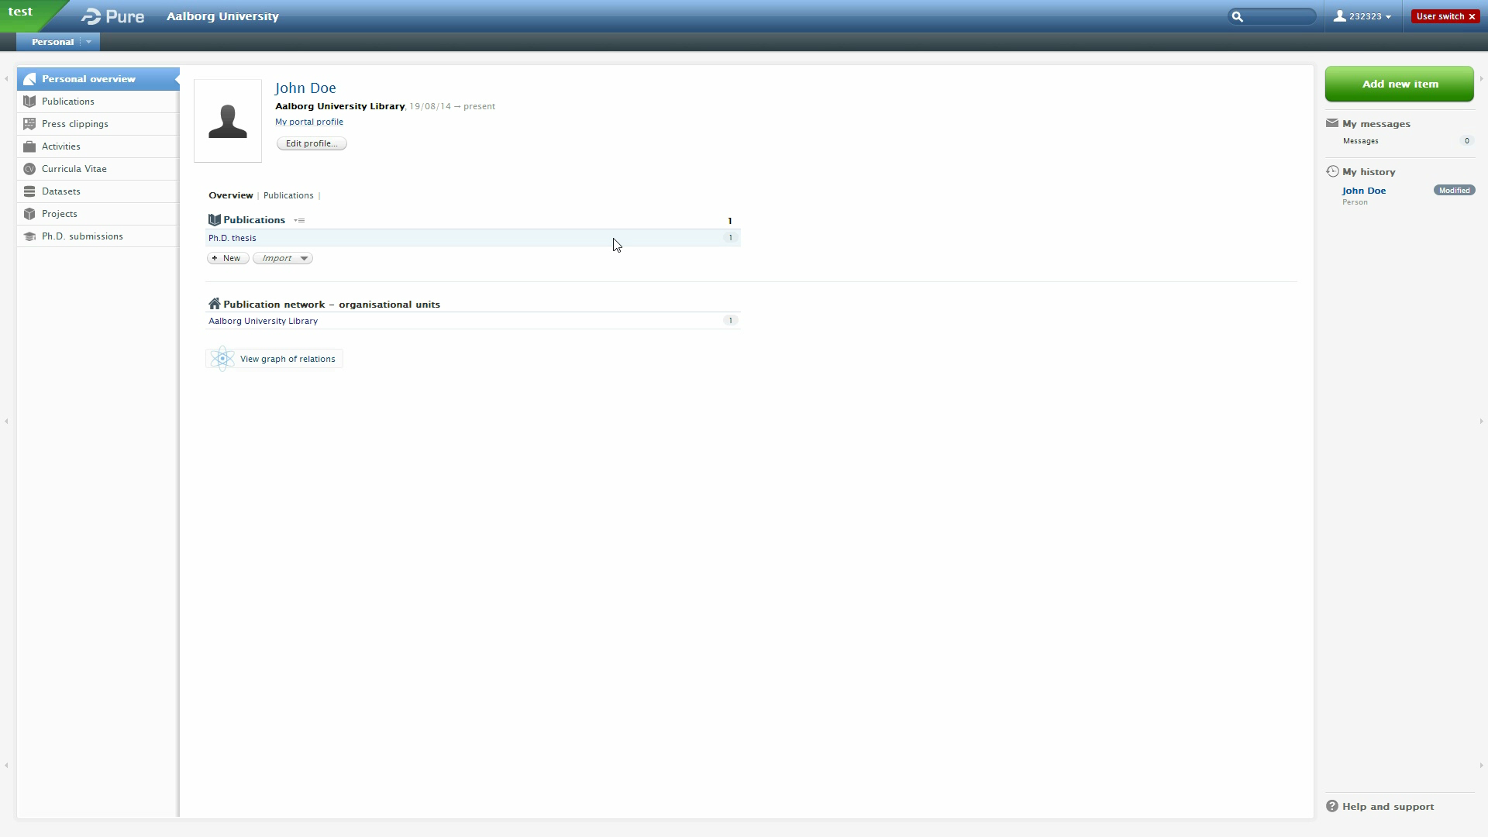
Create or add your ORCID ID in Pure

Slide 30
Local implementation at our university
-
-
-
-
-
-

Slide 31
Final thoughts
Open, non-profit, community-driven organization
It’s free!
You control privacy
Maintain a single identifier that connects with other systems
Get credit for ALL of your research
ID follows you throughout your career
Less time (re)entering data
More time available to conduct research
Notes:
Notes for presenter:

Slide 32
Learn more & get involved
  community@orcid.org
Website resources
  http://support.orcid.org/knowledgebase
  http://orcid.dk
Notes:
Notes for presenter:
If you’re as excited about ORCID as I am, you also have the chance to become an ambassador. If you are interested in more information about the ambassador program or want to talk more about ORCID, see me after the presentation or contact me or Rebecca Bryant, director of community for ORCID.

Slide 33
ORCID IDs: Optimizing Research Discoverability
Updated September 2014
Notes:
Notes for presenter:
Thank you!

